Slide 1


Real Estate Sales
Raj kadam

Slide 2
DATA DESCRIPTION
Dataset Name : “Real_Estate_Sales_2001-2020_GL.csv”
Context : The real estate market has been in a growth phase for several years, which means that you can still find properties at very attractive prices, but with good chances of increasing their value in the future.
Content description :
- Serial Number: Is just a unique set of digits to identify each transaction
- List year: This is the year that the particular property was put up for sale.
Date Recorded: Is the date that the transaction was completed. That is, the year the property was bought.

Slide 3
Town: The town where this property is located.
Address: The property's address.
Assessed Value: How much the property is generally considered to be worth.
Sale Amount: How much the property was actually sold for.
Sales Ratio: The ratio measures how close the selling price of the property is to it's assessed value.
Property Type: What kind of property it is.
-Residential Type: If it is a residential property, what type is it.
Years until sold: Number of years before the property was finally sold

Slide 4
Analysis Average assessed value of properties from year to year
1999 46690.00
2001 135491.72
2002 149383.32
2003 179513.11
2004 195650.60
2005 209550.69
2006 220200.79
2007 347280.94
2008 325780.33
2009 294441.47
2010 342126.09
2011 330744.58
2012 402422.96
2013 354065.15
2014 322815.66
2015 306143.95
2016 307743.61
2017 319719.33
2018 323137.14
2019 306572.08
2020 306832.13
2021 332648.44

Slide 5
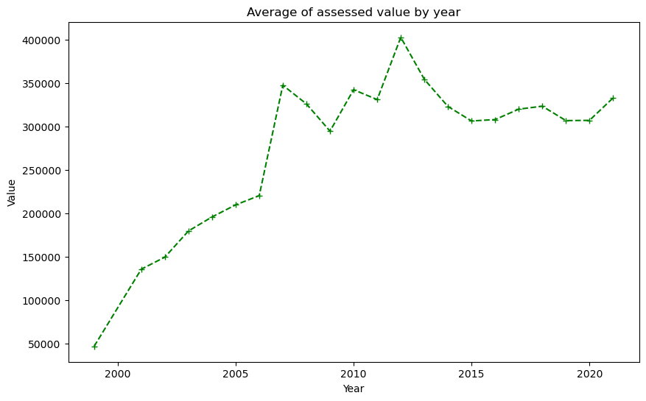
The average value of 2012 is greater among the all year and the year 1999 is less average value in all year .

Slide 6
Analysis the average sale amount of properties from year to year
1999 95000.00
2001 222403.15
2002 259165.45
2003 305480.17
2004 340289.28
2005 379726.61
2006 377261.42
2007 481645.91
2008 412965.58
2009 324367.22
2010 353688.21
2011 344237.60
2012 399134.95
2013 410035.31
2014 395638.27
2015 391299.65
2016 477925.68
2017 390788.82
2018 391118.94
2019 396059.71
2020 435233.68
2021 656046.40

Slide 7
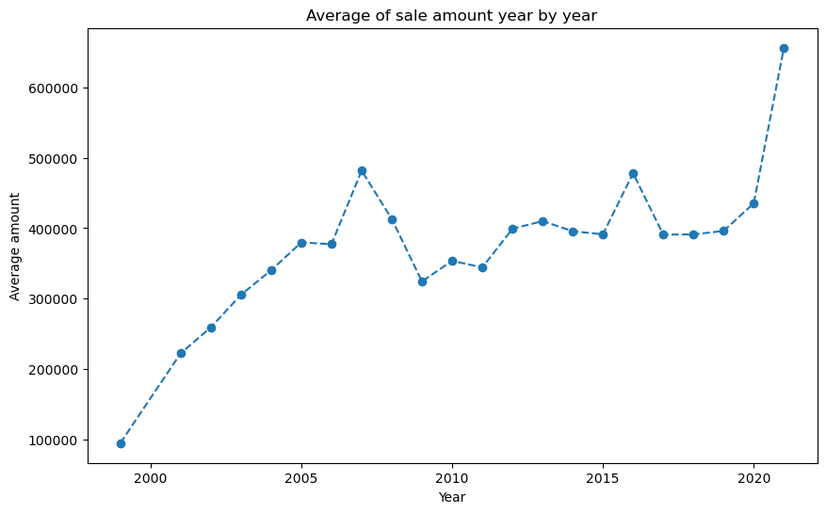
The 2021 year is greatest average from all year also 2007 is 2nd highest average and 1999 is less sales average .

Slide 8
Analysis average sales ratio of properties from year to year
1999 0.49
2001 8.39
2002 4.55
2003 1.28
2004 13.12
2005 2.01
2006 83.10
2007 53.36
2008 1.89
2009 1.79
2010 2.32
2011 2.62
2012 2.61
2013 2.07
2014 2.18
2015 1.88
2016 3.75
2017 1.87
2018 10.31
2019 1.68
2020 0.99
2021 0.85

Slide 9
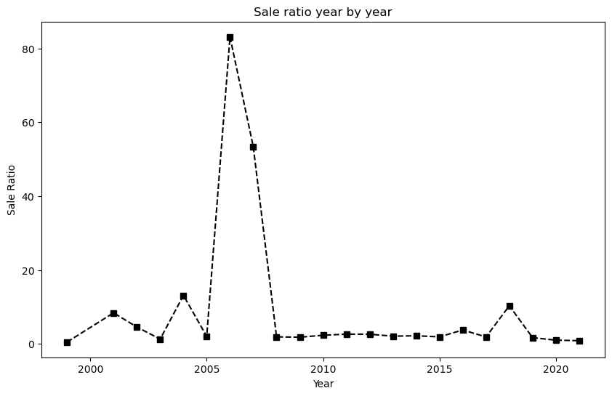
In the year 2006 the sale is higher from all years and also 2007 has high sale ratio.

Slide 10
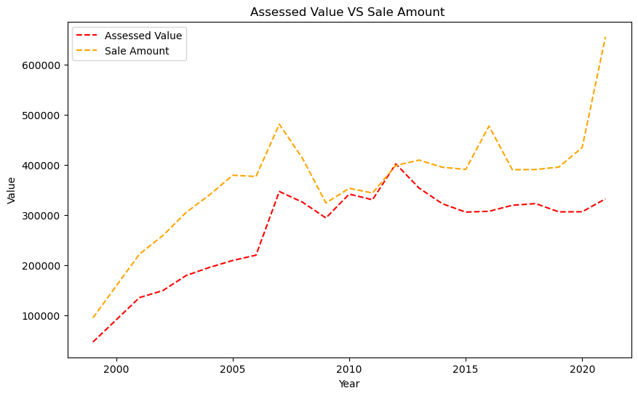
Comparing the Assessed Value and Sale Amount

Slide 11
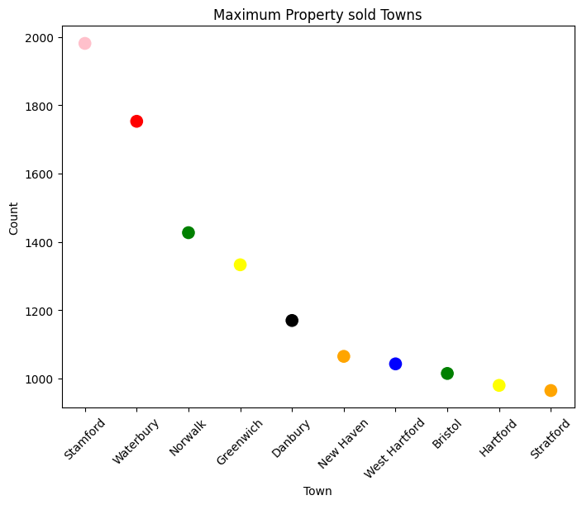
Analysis by towns the most property sold in 2021
Stamford 1981
Waterbury 1753
Norwalk 1427
Greenwich 1333
Danbury 1170
New Haven 1065
West Hartford 1043
Bristol 1015
Hartford 980
Stratford 965

Slide 12
Analysis by year property is most listed
2004 84056
2020 66592
2003 64239
2005 61602
2002 59682
2001 59584
2019 58954
2018 50709
2016 49773
2014 49563
2006 48785
2015 46651
2017 45691
2009 42508
2013 39943
2012 35973
2007 35617
2010 33491
2008 32735
2011 31065

Slide 13
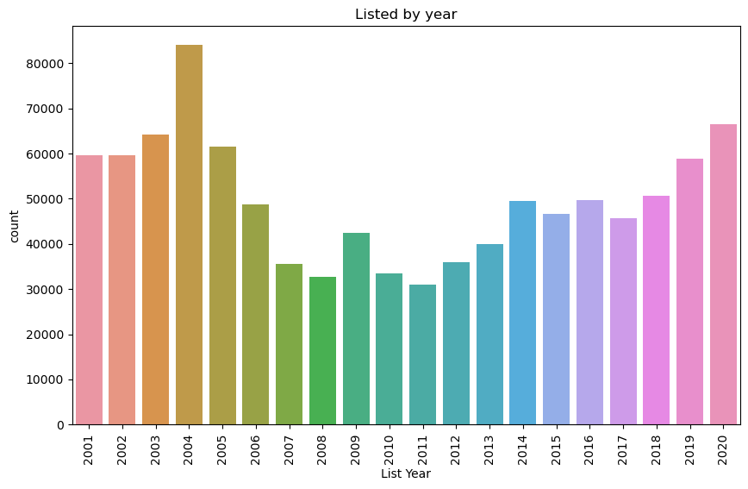
In Year 2004 there are 84056 property has listed in market and also Year 2020 there are 66592 property is listed . Year wise property listed going up .

Slide 14
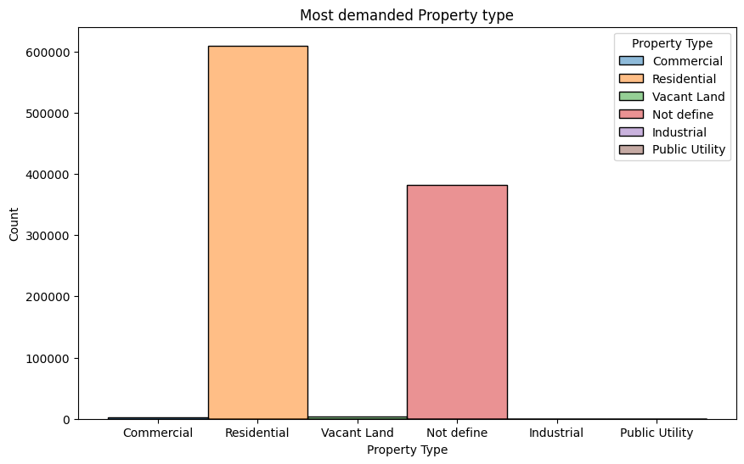
Analysis by property type is most demanded in market
Residential 609390
Not define 382446
Vacant Land 3163
Commercial 1981
Industrial 228
Public Utility 5

Slide 15
Analysis by Top 10 town has maximum property sold
Bridgeport 34201
Stamford 32529
Waterbury 28506
Norwalk 23960
New Haven 21346
Danbury 20350
West Hartford 19854
Hartford 18810
Milford 17749
Meriden 17502

Slide 16
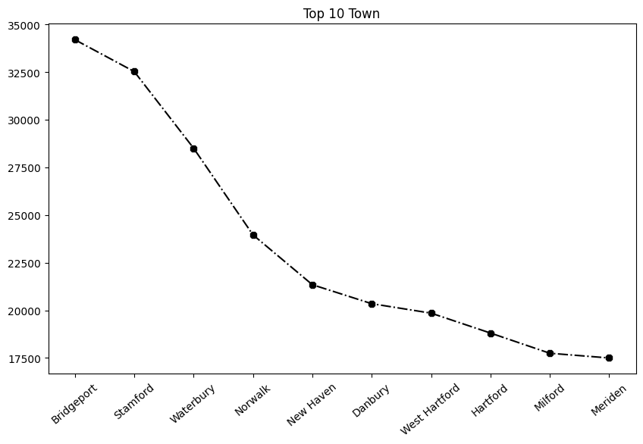
The Bridgeport has sold maximum property its almost 34201 and Stamford also sold property 32529.

Slide 17
Analysis by the year sale of residential property
2020 57850
2019 48348
2015 44940
2017 44609
2021 44352
2016 43681
2018 43085
2007 40956
2014 38112
2010 35715
2013 34223
2009 33457
2008 30749
2012 29427
2011 28892
2006 10977
2001 6
2004 6
2005 3
2003 1
1999 1

Slide 18
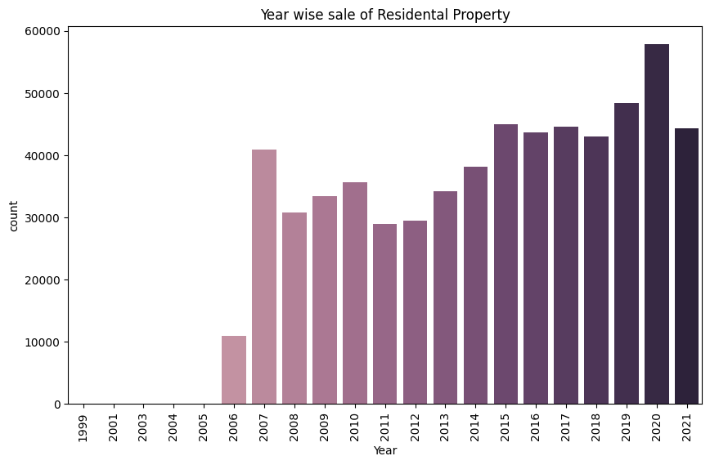
The residential property in year 2020 has 57850 sold , its good growth year wise and also year 2019 residential property has 48348 sold but at the stating year no market for residential property.

Slide 19
Analysis by the month wise sale 2018
Month Number
1 1.122237e+09
2 1.040065e+09
3 1.120680e+09
4 1.356939e+09
5 1.750086e+09
6 2.007579e+09
7 2.166187e+09
8 2.006172e+09
9 1.174589e+09
10 1.692171e+09
11 1.394021e+09
12 1.616398e+09
In the Year 2018 Month of July noted as maximum sale in year also June & August has good sale in Year Its sign that June, July & August has Peak in month for Buying property.

Slide 20
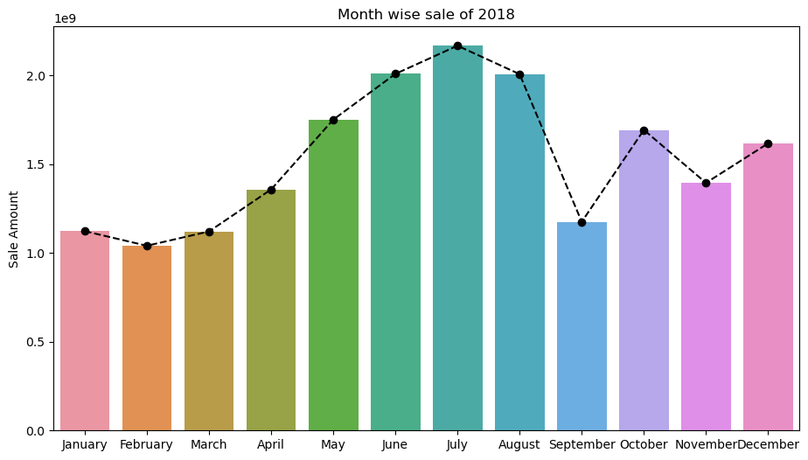

Slide 21
Analysis by the month wise sale of 2019
Month Number
1 1.174033e+09
2 9.344536e+08
3 1.159761e+09
4 1.308926e+09
5 1.973320e+09
6 2.176920e+09
7 2.591234e+09
8 1.805868e+09
9 1.649248e+09
10 1.906338e+09
11 2.130028e+09
12 2.031326e+09
In the year of 2019 July Month has reach maximum sale in year also June & November achieve good sale in the year but February is not achieve good sale in the year 2019.

Slide 22
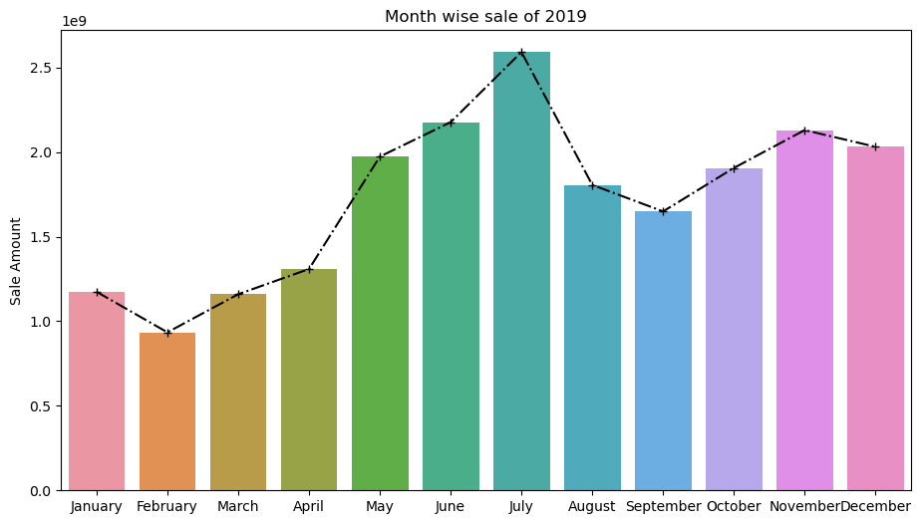

Slide 23
Analysis by the month wise sale of 2021
Month Number
1 3.828233e+09
2 1.633432e+09
3 2.364804e+09
4 2.501845e+09
5 2.755317e+09
6 3.522901e+09
7 4.192108e+09
8 8.235308e+09
9 2.745595e+09
In the Year 2021 August month achieve maximum sale also July and January achieve good sale but February Not achieve good sale in the 2021.

Slide 24
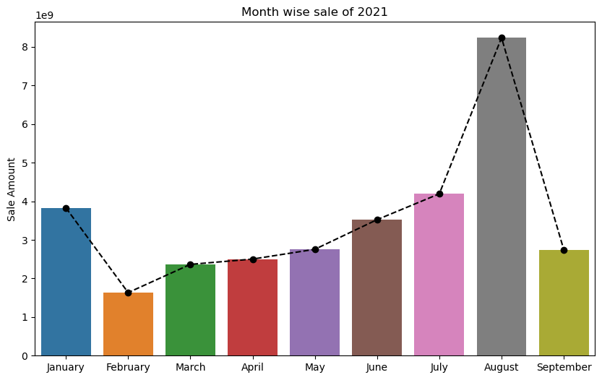

Slide 25
Analysis by year wise profit VS loss
1999 4.831000e+04
2001 1.242051e+09
2002 6.609653e+09
2003 7.094339e+09
2004 1.069502e+10
2005 1.354022e+10
2006 8.991721e+09
2007 6.199331e+09
2008 2.981300e+09
2009 1.086454e+09
2010 4.524025e+08
2011 4.329639e+08
2012 -1.070839e+08
2013 2.099609e+09
2014 3.054253e+09
2015 4.163603e+09
2016 8.102539e+09
2017 3.446373e+09
2018 3.206362e+09
2019 4.709018e+09
2020 8.029463e+09
2021 1.566572e+10
In year 2021 has maximum profit earn from other year and also in Year 2020 achieve good profit but Year 2012 has book the loss of amount one hundred seven million eighty-three thousand nine hundred dollars its serious things to us.

Slide 26
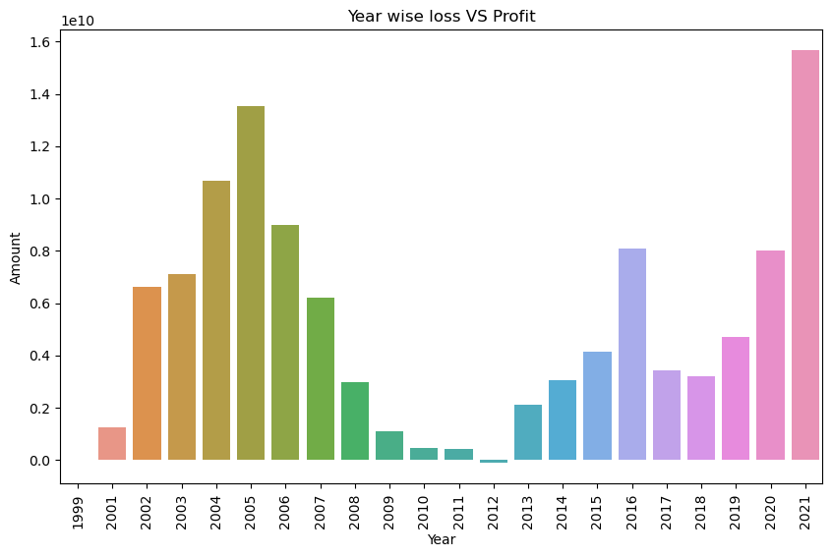

Slide 27
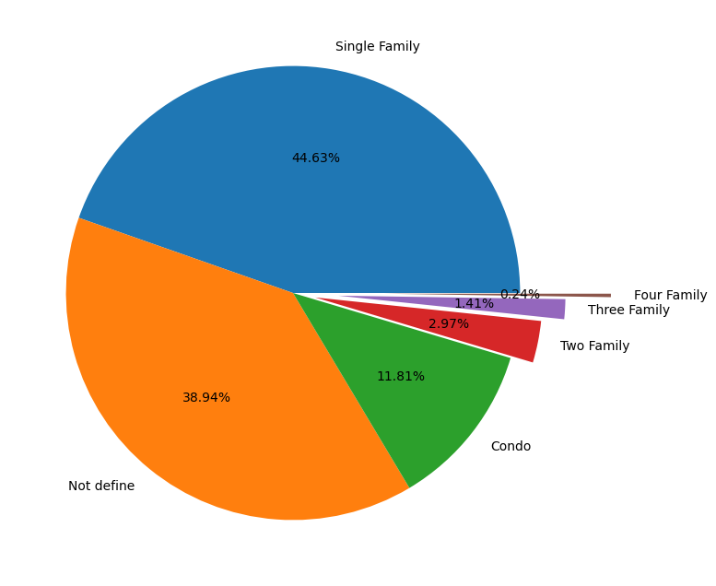
Analysis by residential types purchased most property
Residential Type
Single Family 445016
Not define 388309
Condo 117780
Two Family 29609
Three Family 14081
Four Family 2418

Slide 28
Analysis by the month wise profit of 2020
Month Number
1 4.563204e+08
2 3.335736e+08
3 3.056115e+08
4 3.433488e+08
5 2.188625e+08
6 3.818423e+08
7 6.933040e+08
8 1.394953e+09
9 8.153652e+08
10 9.919490e+08
11 9.553071e+08
12 1.139026e+09
In Year 2020 August has book maximum profit and also December has book profit has good but May has not good profit is less from other months.

Slide 29
